Slide 1
DEMOCRATIC GOVERNANCE AND INSTITUTIONS FOR GROWTH Kim Eric Bettcher Knowledge Management Officer Center for International Private Enterprise (CIPE)

Slide 2
The evolution of institutions
Douglass North described the institutions needed to raise productivity and encourage long-term economic growth
Property rights, enforcement of contracts, etc.
Democracy is the political environment in which these institutions can best develop and be sustained

Slide 3
Democracy vs. authoritarian rule
Myth: Authoritarian governments can more easily establish policies for growth
What if you have an unenlightened despot?
Rule by personal relationships and patronage
Many authoritarians distort markets instead of creating them
Productivity and innovation don’t occur in closed, repressive environments

Slide 4
No need to choose between democracy and development
Myth: Developing countries can’t afford democracy
Empirical evidence shows that authoritarian regimes don’t have a better record
Democracy can create a positive environment for markets and growth
Countries do not have to choose between democracy and economic development

Slide 5
Common elements of democracy and a market economy
Political and economic freedom
Competition, choices, and incentives
Predictability (stable rules of the game)
Shared values
Transparency
Responsibility
Fair chance to participate

Slide 6
Democracy provides stability necessary for economic growth
Stability
Dani Rodrik: Democracies have lower volatility in economic performance
Leadership succession through institutionalized, predictable means
Rule of law protects property, applies to all
Legitimacy – stakeholders not excluded from the system
Mitigates social pressures, polarizing attitudes

Slide 7
Democracy provides context for creating good policies
Checks on authority
Limits to abuses
Accountability to taxpayers
Responsiveness to constituents
Even the wisest technocrat can’t come up with the optimum economic policies
Good policies require grassroots-level information

Slide 8
Democracy allows for input into policymaking and feedback
Private sector input in policymaking
Source of micro-level information
Debate and alternative solutions
Feedback
Transparent relationship between public and private sectors
Adaptability – democracy avoids rigid policies and volatile policies

Slide 9
Real democracy entails good governance
Effective government
Public administration
Laws and regulations
Responsive, accountable government
Transparency, freedom of information
Rule of law
Citizen participation in the policy process

Slide 10
The quality of representation
Successful policymaking depends on participation and effective representation
Rent-seeking undermines growth
Countries need diverse inputs into policy that will benefit the economy overall
The challenge is to find a policy environment where diverse groups can participate
Policymaking should not be a zero-sum game

Slide 11
The role of associations
Freedom of association
Representative
Inclusive
Coalition building
Public-private dialogue
Transparent process
Quality information and solutions
Private sector is a good source of economic information and data

Slide 12
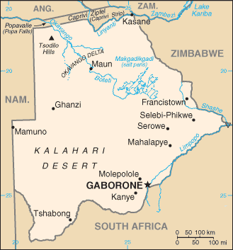
The example of Botswana
Democracy provided a favorable environment for economic growth
Property rights
Constraints on authority
Responsiveness
Development of public-private
policy dialogue
Botswana Confederation of
Commerce, Industry & Manpower (BOCCIM)

Slide 13
ENDING

